Slide 1



SOFTWARE DEVELOPMENT PROFESSIONAL PROGRAM
Introduction to HTML

Slide 2





Introduction to HTML
Learning Objectives
Describe the format of an HTML document.
Name several common HTML tags, including links, images, and text.
Tell the difference between tags, their attributes, and their content.

Slide 3

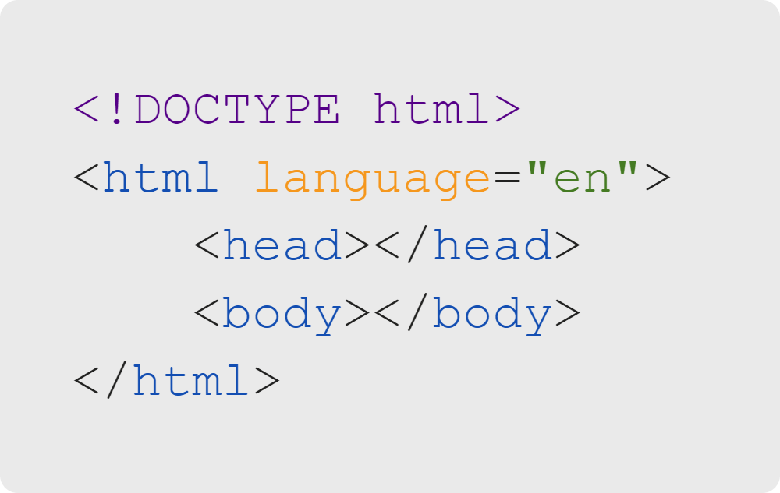
Introduction to HTML
Let's Review!
DOCTYPE
The HTML skeleton
Head and body sections
Notes:
These are the bare bones of any HTML document. Any content contained in the head tag is hidden, while
any content within the body tag will be visible.
<< Refer to LC exercise 1: Review >>

Slide 4
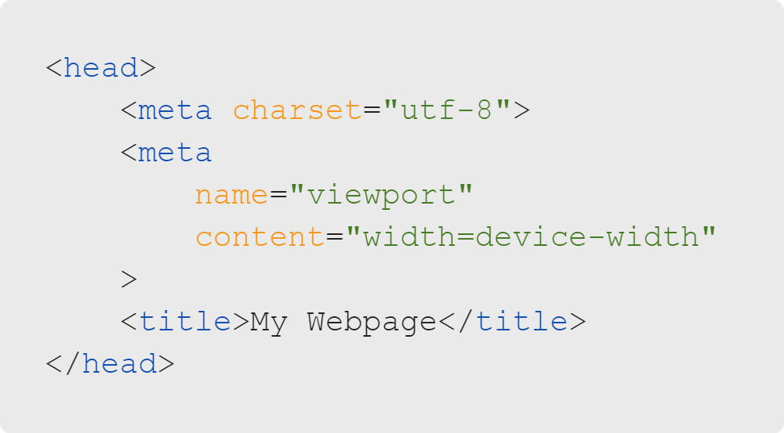
Introduction to HTML
Let's Review!
Title
Meta-information

Slide 5
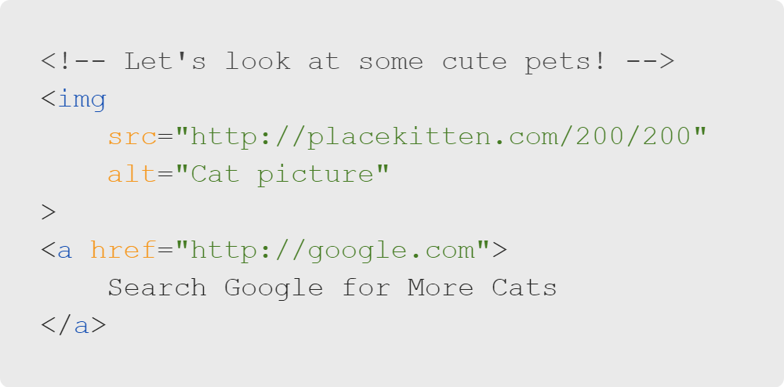
Introduction to HTML
Let's Review!
Comments
Attributes
Links to external resources

Slide 6
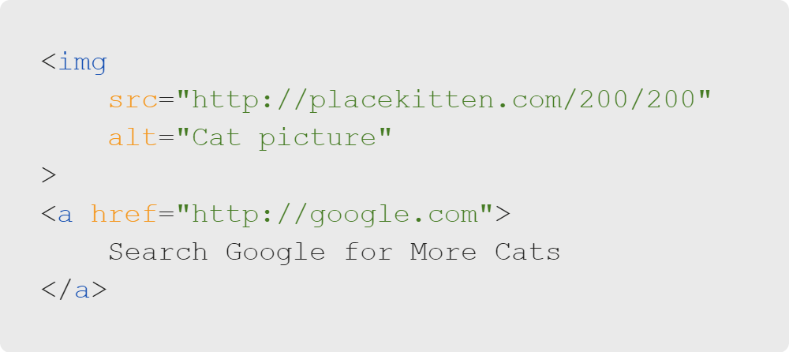
Introduction to HTML
Self-Closing Tags
Some HTML tags don't have content, so they do not need a separate closing tag.
Examples are img, meta, hr
Notes:
<< Refer to LC exercise 2: Self-Closing Tags >>

Slide 7
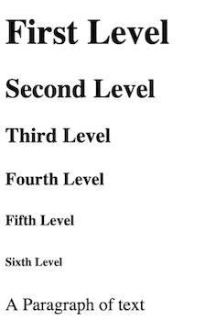
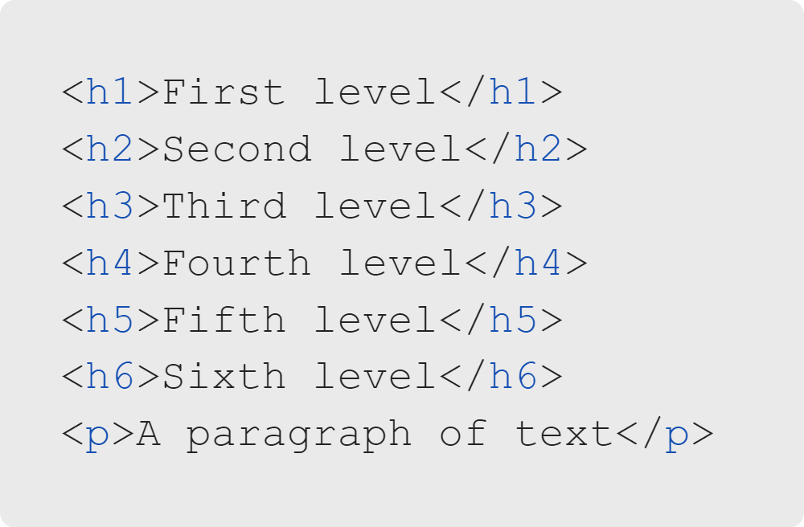
Introduction to HTML
All Kinds of Text
Notes:
<< Refer to LC exercise 3: Headers >>

Slide 8
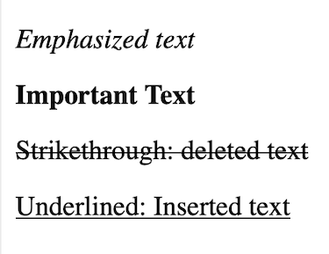
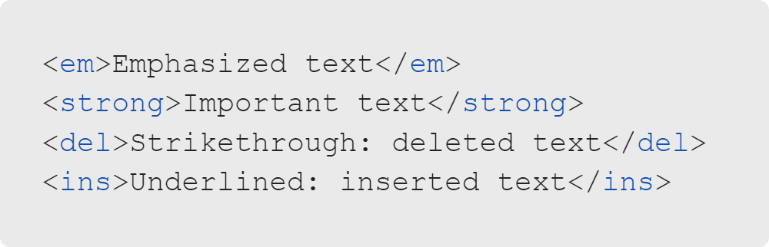
Introduction to HTML
All Kinds of Text
Preferred, semantic (meaningful) tags
Notes:
<< Refer to LC exercise 4: Deleted/Inserted Text >>

Slide 9
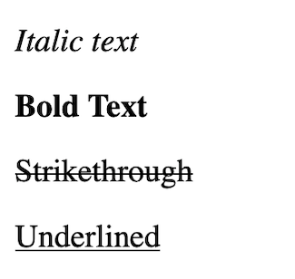
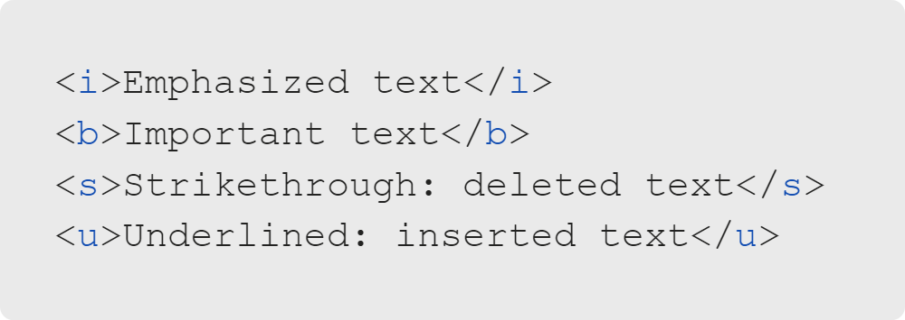
Introduction to HTML
All Kinds of Text
General use tags, only when semantic tags don't fit

Slide 10
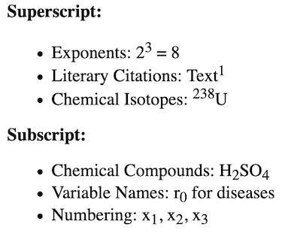
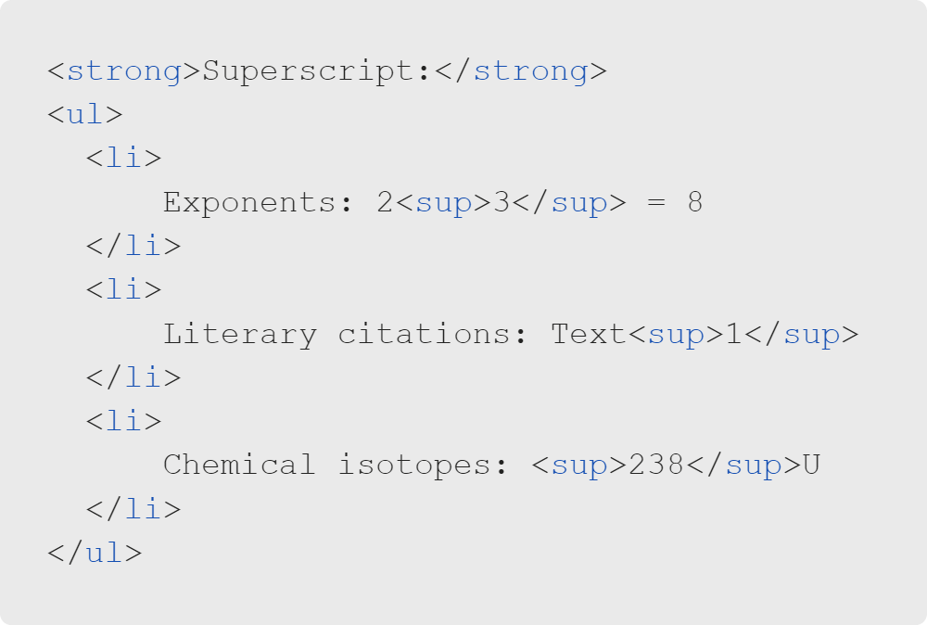
Introduction to HTML
All Kinds of Text
Notes:
<< Refer to LC exercise 5: Superscript & Subscript >>

Slide 11
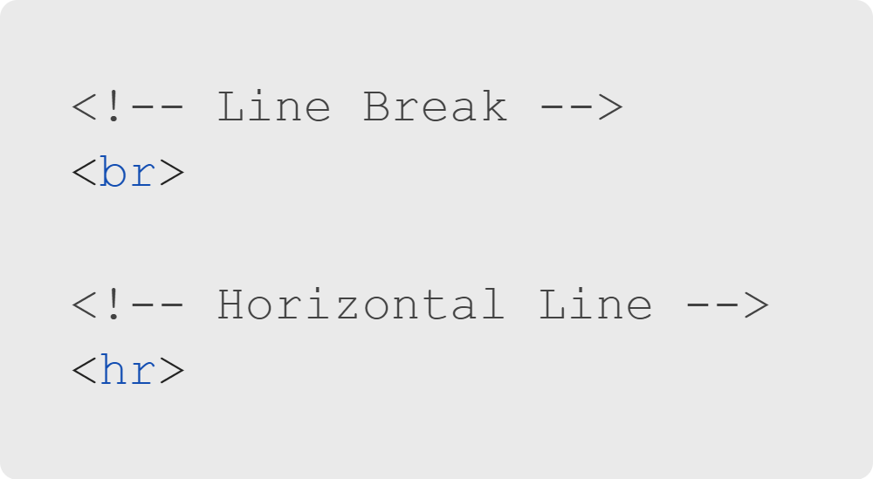
Introduction to HTML
Formatting
Page formatting
Soon we'll learn that a lot of this can be done with CSS, too!

Slide 12

Introduction to HTML
Attributes
href doesn't work on img!
src doesn't work on a!

Slide 13
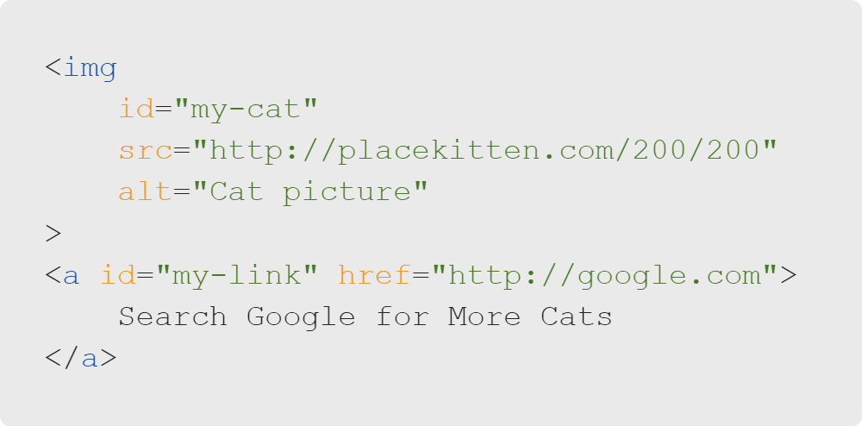

Introduction to HTML
Attributes
Some attributes are universal (e.g., id, class).

Slide 14

Introduction to HTML
Quiz: Multiple Choice
How do we know which attributes are accepted by a tag?
A. Memorize them for each tag.
B. Look up documentation.
C. Guess and check until you figure it out.
D. Use only universal attributes.

Slide 15
Introduction to HTML
Quiz: Multiple Choice Answers
How do we know which attributes are accepted by a tag?
🚫 A. Memorize them for each tag.
✅ B. Look up documentation.
🚫 C. Guess and check until you figure it out.
🚫 D. Use only universal attributes.

Slide 16

Introduction to HTML
Documentation
It's not like the movies...
In real-life, documentation is a lifeline!
For all programming-not just HTML!

Slide 17
Introduction to HTML
Documentation
Great places to start:
So, who makes HTML documentation?
W3Schools (w3schools.com)
Mozilla Developer Network (developer.mozilla.org)
Major industry groups that create tutorials or make internet browsers

Slide 18

Introduction to HTML
Documentation
Open a new tab in your browser and visit the Mozilla Developer Network:
https://developer.mozilla.org/en-US/docs/Web/HTML

